Slide 1
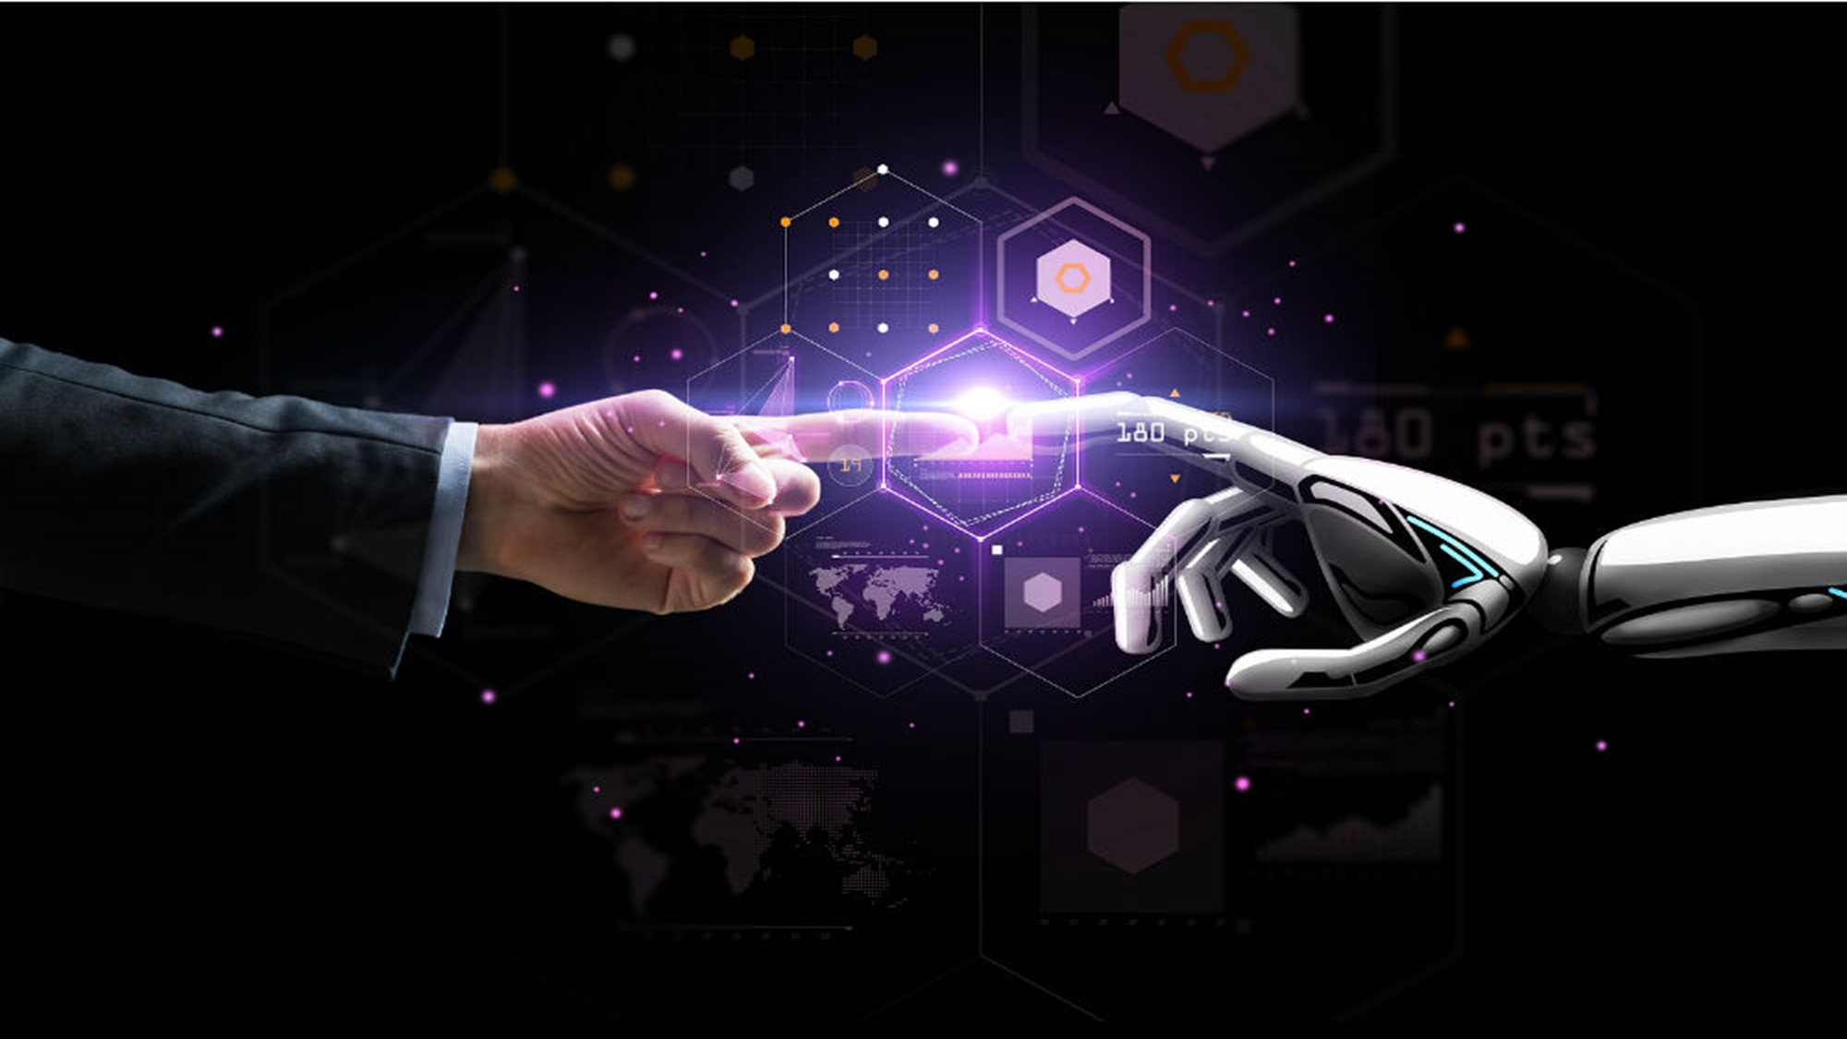
SMART CROP PROTECTION USING IOT
DOMAIN NAME :
INTERNET OF THINGS

Slide 2
PRESENTED BY
VIGNESH.R (211119205501)
GUIDED BY
Ms.G.Monica,MCA,M.Phil.,

Slide 3
ABSTRACT
Agriculture has become more industrialized and intensive due to the rising demand for food in quality and quantity. Agricultural modernization will be made possible by the Internet of Things (IoT), a technology with a great promise for revolutionizing the industry. Agricultural products will be in high demand by 2050 due to a 30% increase in the global population, so there is a need to devise new mechanisms for agriculture, and smart agriculture is one of those mechanisms; however, smart agriculture needs to be explored further to realize its potential fully. So, to explore the potential of this field, the researchers have used a corpus that is extracted from the Scopus database from the year 2008 to the year 2022 and applied the LDA technique. A corpus of 4309 articles was selected from the Scopus database to apply the latent Dirichlet analysis (LDA) model to predict research areas for smart agriculture. Using IoT technology, farmers and producers may better manage their resources, such as fertilizer consumption and the number of trips made by farm vehicles, while minimizing waste and maximizing productivity, including water, electricity, and other inputs. This data-driven experimental study identifies smart agriculture research trends by implementing a topic modelling technique previously used in smart agriculture.

Slide 4
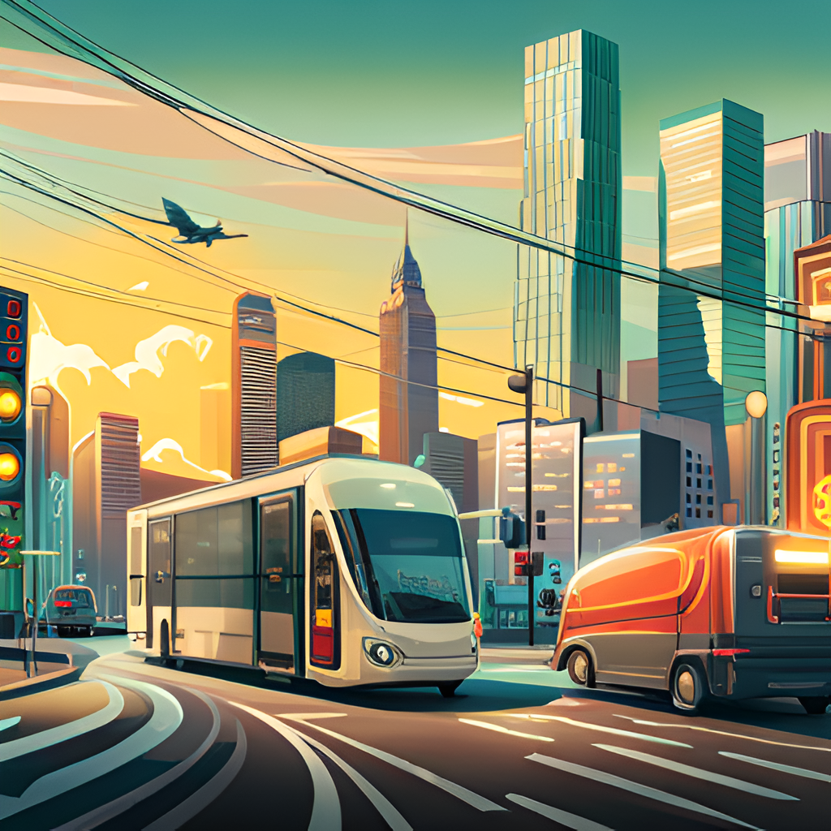
Introduction to the Internet of Things
The Internet of Things (IoT) refers to the network of physical devices, vehicles, home appliances, and other items embedded with electronics, software, sensors, and connectivity that enables these objects to connect and exchange data.
The IoT has the potential to revolutionize various industries, including healthcare, transportation, and manufacturing, by allowing for increased efficiency, automation, and data analysis.

Slide 5
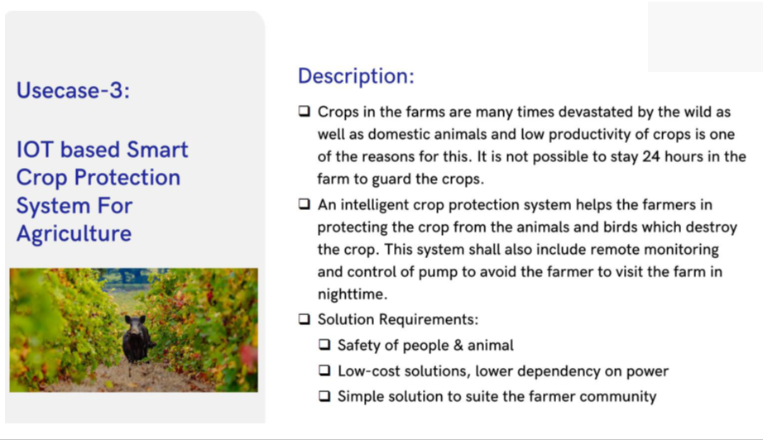
LITERATURE SURVEY

Slide 6
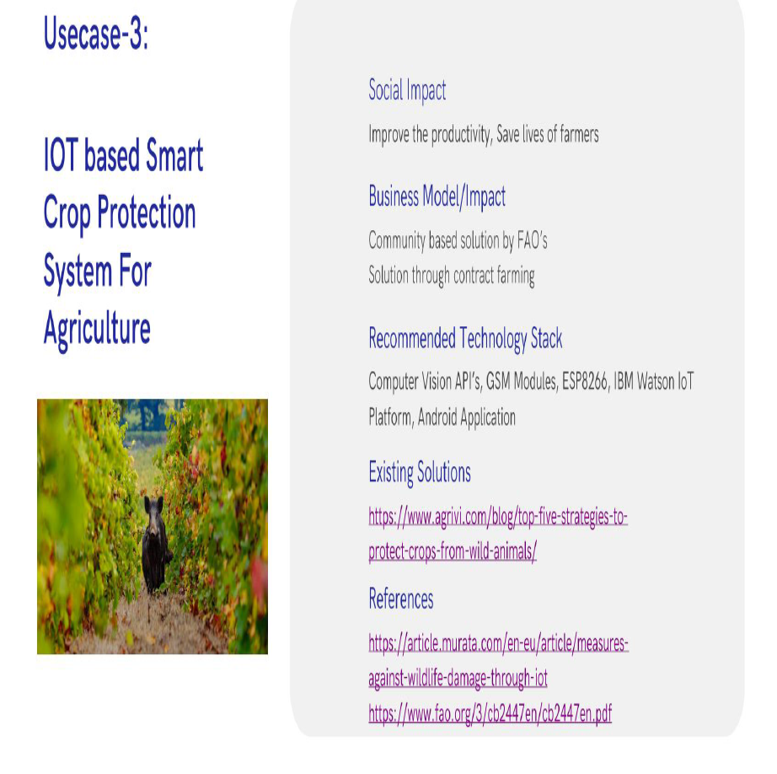

Slide 7
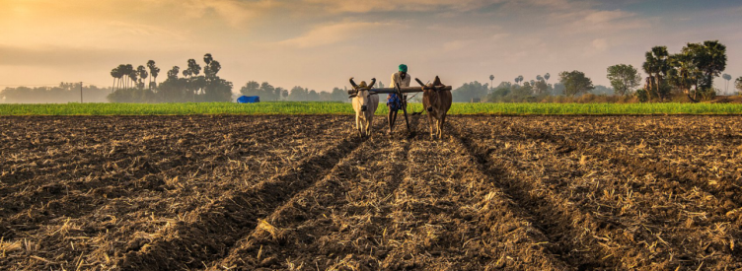
SYSTEM REQUIRMENTS ANALYSIS
EXISTING SYSTEM
TRADITIONAL FARMING
traditional farming to smartfarming will have significant implications for the biodiversity of cultivated and wild plants.
In the face of global environmental problems, it is essential that agriculture remains resilient to maintain and increase food security.
Cultural and biological diversity are essential to agricultural resilience; if one method or crop fails, there are many to compensate.
Cultural diversity can maintain biodiversity if the pressure to modernize is reduced and the number of conservation projects continue to grow.

Slide 8
DISADVANTAGES
Farmers in traditonal farming have to spent mainly about 15 hours to harvest the crops compared to high-tech farming.
It takes a long time to harvest hence beingsold more expensive prices to earn back the time taken to mature the crops.
Soil is used in traditional farmming.Hence,decomposition takes up majority of the time.
Also,this places the crops in a high risk of getting soil disease.
Pesticides are used to prevent pests fromattacking the crops.Hence,plants are not so healthy.

Slide 9
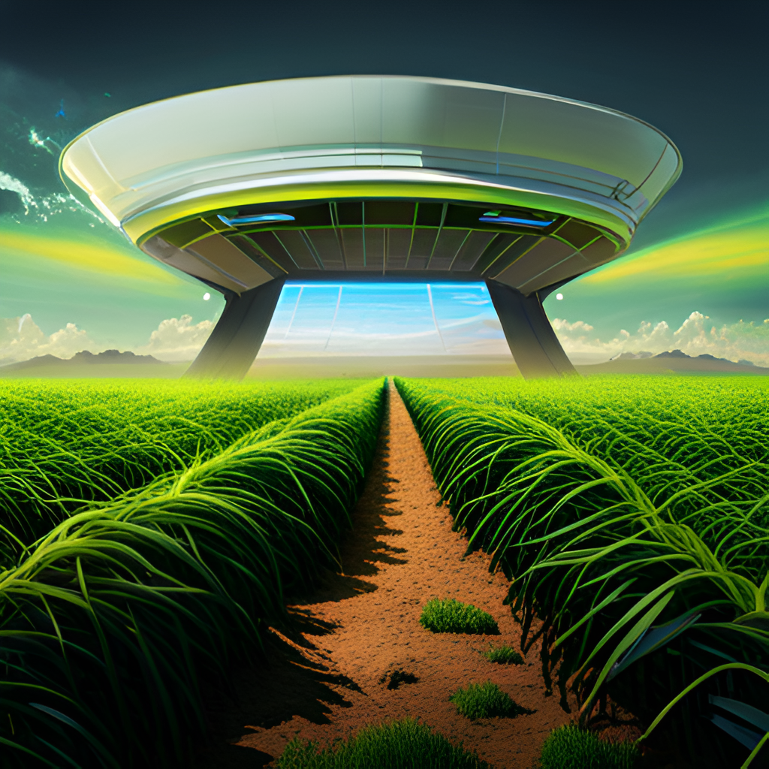
What is a smart farm?
A farm which is managed using smart technologies and modern forms of communication is termed as a smart farm.
The several of technologies farmers use in smart farms are:
Sensors for soil, water, moisture and humidity control
Software to diagnose plant and animal disease, to learn and treat the disease.
The smart farms are completely operated by automated tools and robotics in such a manner that the farmer does not even have to step on the field. The cost of manual labour reduces due to smart farming. IoT integrates and connects the entire farm to improve quality and quantity of crops and other produce.

Slide 10
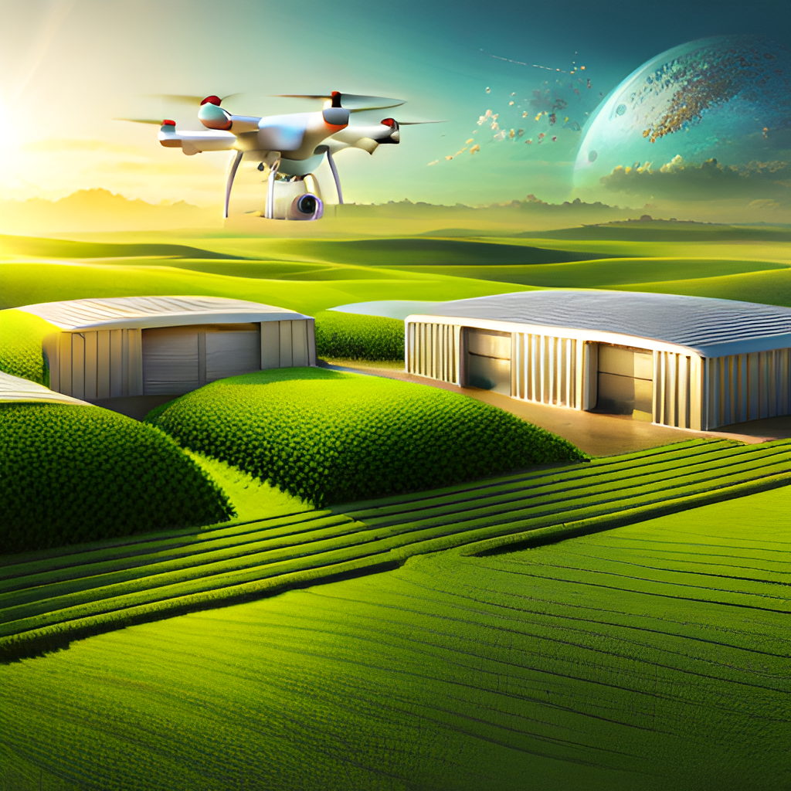
PROPOSED SOLUTION
SMART CROP PROTECTION
The modernization of farm operations fueled by the increasing technology adoption rate makes farm management a little less laborious and a lot more rewarding. However, the evolution of digital technology has resulted in several new concepts, some of which are used interchangeably.
we explore two very similar but not identical concepts: precision agriculture and smart farming. involves highly controlled, accurate, and optimized agricultural production. It facilitates more efficient resource utilization, better yield, and reduced environmental impact, all at the same time. An ideal example of the precision farming practice is a focused agrochemical application with AI-aided analysis, targeting only areas that need attention instead of the blanket application.
This farming practice involves the implementation of modern information and communication technologies . Producers also incorporate a combination of devices and machinery that help capture vital field data,
including :
Remote sensors
Automated hardware and software
Telematics
Drones
Autonomous vehicles
GPS soil sampling

Slide 11
ADVANTAGES
The microcontroller now sounds an alarm to woo the animals away from the field as well as sends sms to the farmer so that he may know about the issue and come to the spot in case the animals don't turn away by the alarm. This ensures complete safety of crops from animals thus protecting the farmers loss.
Increased work efficiency. One of the greatest things about Smart Farming is its potential to save valuable time.
Improved fuel efficiency. Smart Farming allows farmers to be much more precise.
Reduced consumables.
Increased yields.

Slide 12
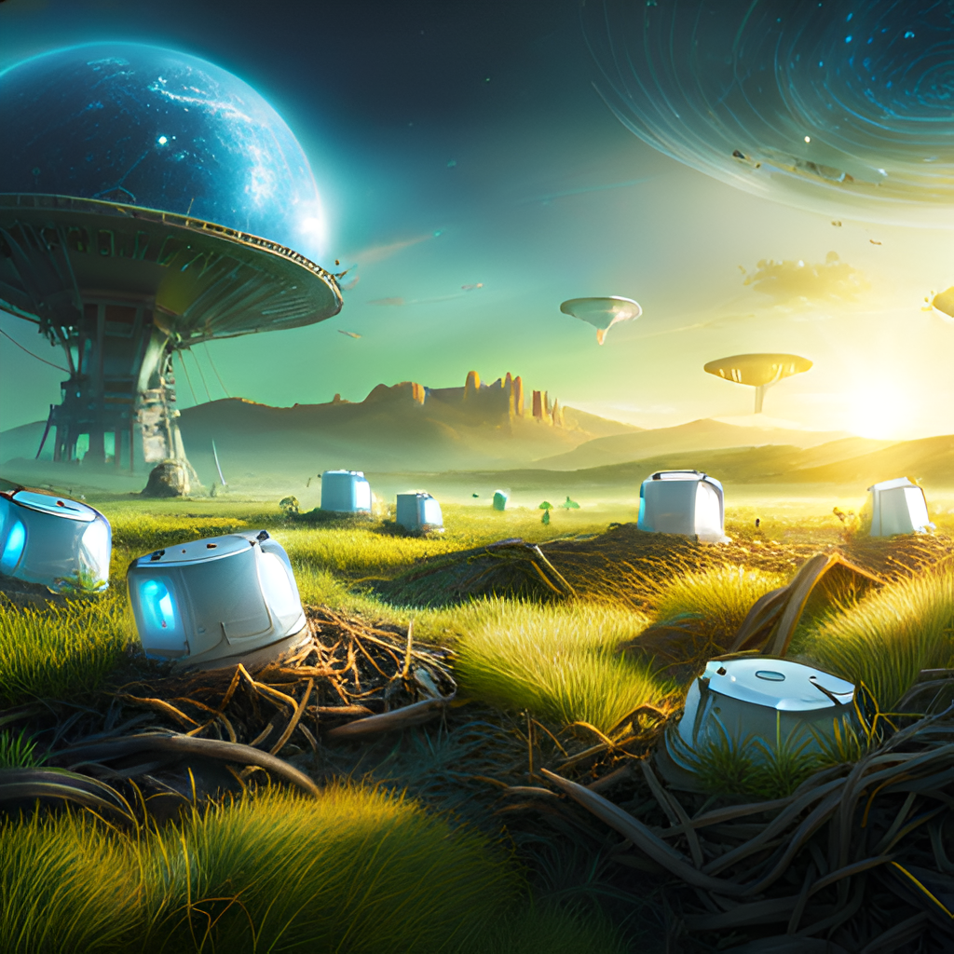
Sensors and IoT Devices
The first step in smart crop protection is the deployment of sensors and IoT devices throughout the farm. These devices can be used to monitor a wide range of environmental factors such as temperature, humidity, soil moisture, and light levels. They can also be used to track the growth and development of individual plants, allowing farmers to identify potential issues early on.
By collecting data from these devices and analyzing it using machine learning algorithms, farmers can gain valuable insights into the health of their crops and make informed decisions about when to apply treatments.

Slide 13
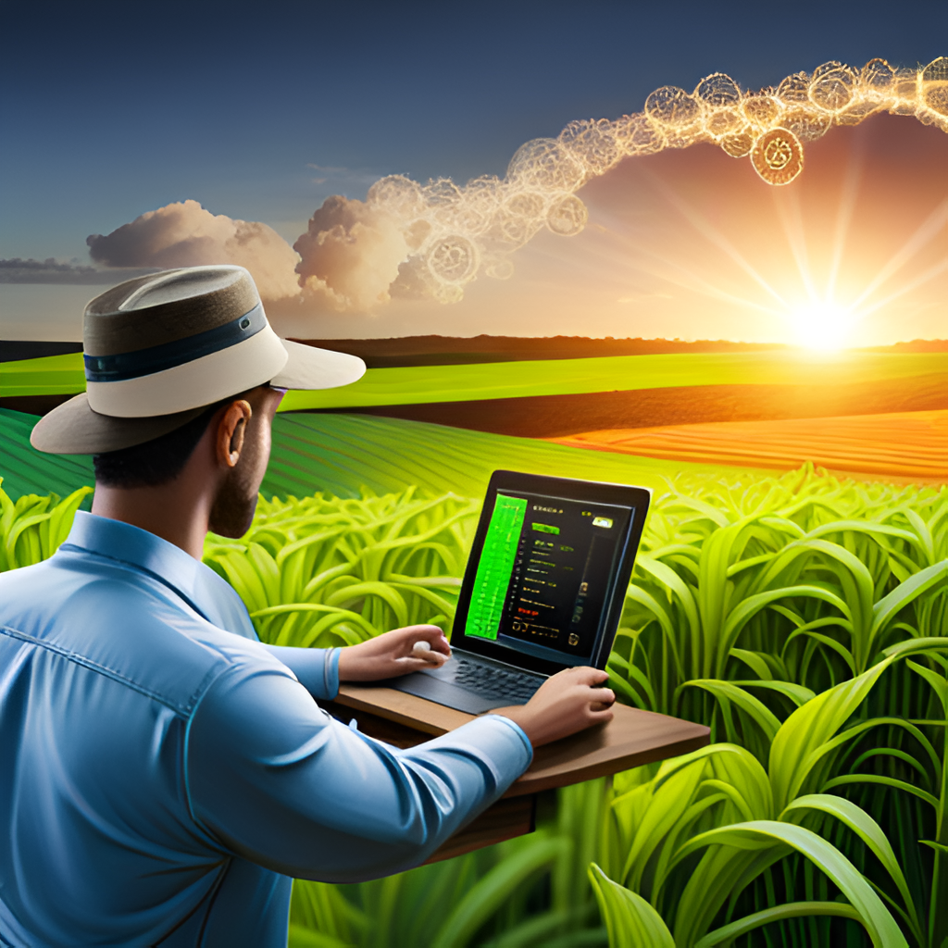
Machine Learning and Predictive Analytics
One of the most powerful aspects of smart crop protection is the ability to leverage machine learning and predictive analytics to make data-driven decisions. By analyzing data from sensors, IoT devices, and drones, farmers can develop predictive models that can forecast potential threats to their crops.
This allows farmers to take proactive measures to prevent issues before they occur, such as applying treatments at the right time or adjusting irrigation schedules based on predicted weather patterns. By constantly refining these models with new data, farmers can continuously improve their crop protection strategies over time.

Slide 14
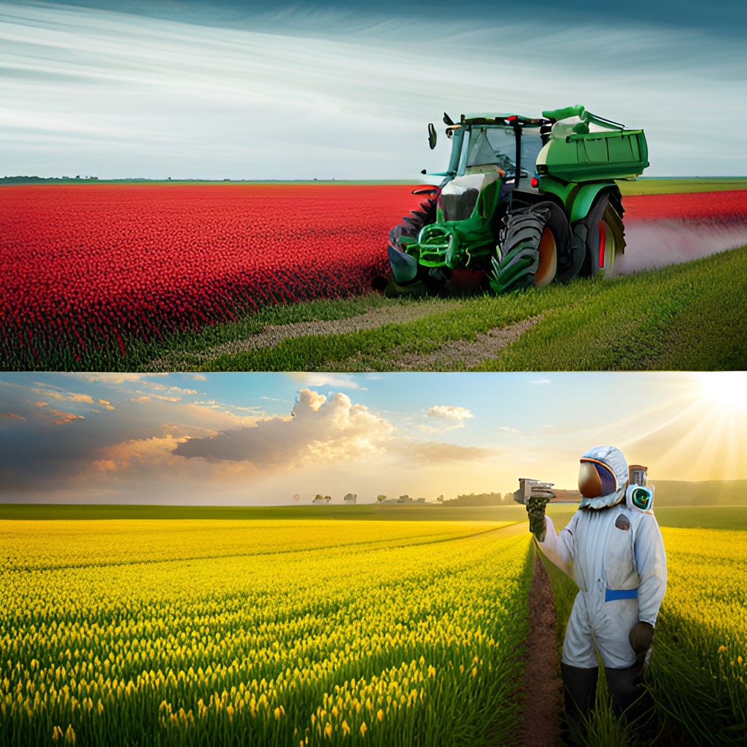
Reducing Pesticide Use
One of the key benefits of smart crop protection is the ability to reduce the use of pesticides and other harmful chemicals. By monitoring crops in real-time and applying treatments only when necessary, farmers can minimize the amount of pesticides they use while still maintaining high crop yields.
This not only benefits the environment by reducing the amount of harmful chemicals released into the ecosystem, but it also benefits farmers by reducing costs associated with purchasing and applying these treatments.

Slide 15
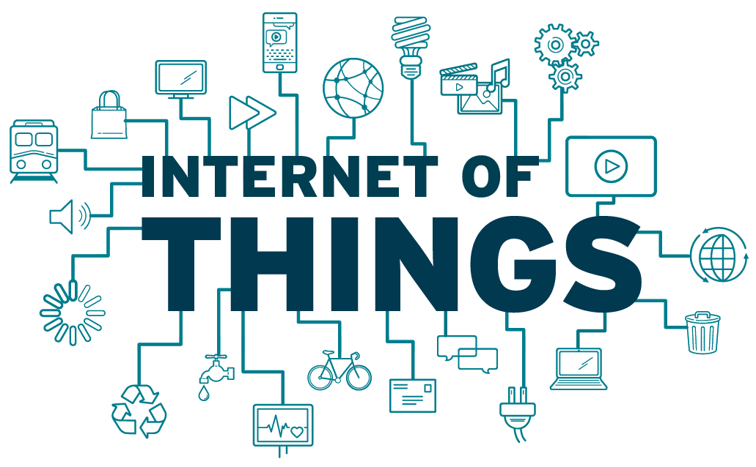
Benefits of the Internet of Things
The IoT can improve efficiency and productivity in various industries by automating processes and providing real-time data analytics.
In healthcare, the IoT can help monitor patients remotely and provide personalized care, while in transportation, it can optimize traffic flow and reduce accidents through vehicle-to-vehicle communication.

Slide 16
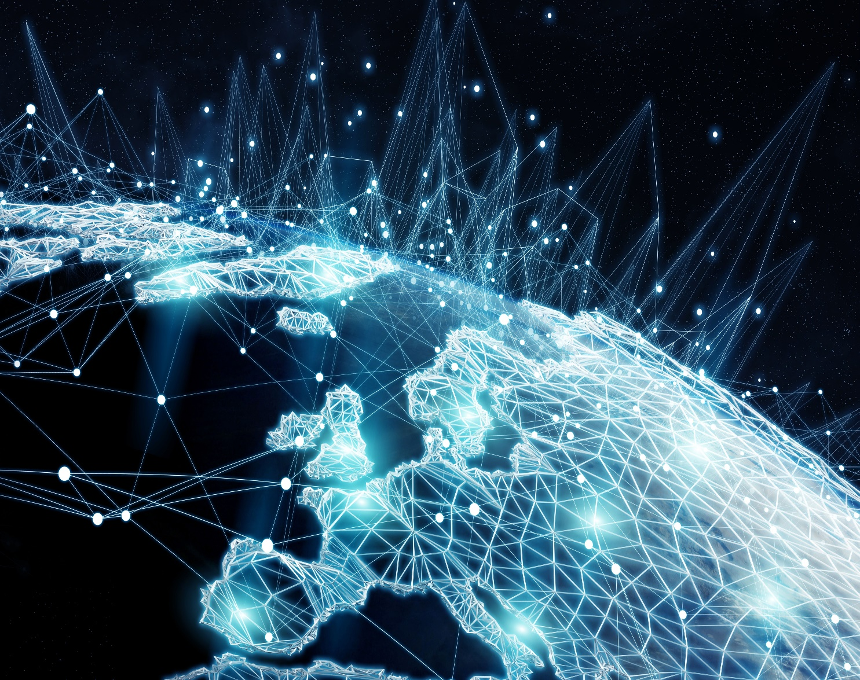
Challenges of the Internet of Things
One of the main challenges of the IoT is security, as the vast amount of connected devices creates numerous entry points for hackers.
Another challenge is the lack of standardization and interoperability between different devices and platforms, which can hinder communication and integration.

Slide 17

Privacy Concerns in the Internet of Things
As the IoT collects and shares vast amounts of personal data, there are concerns about privacy and data protection.
There is also the risk of data breaches and unauthorized access to sensitive information, particularly in industries such as finance and healthcare.

Slide 18
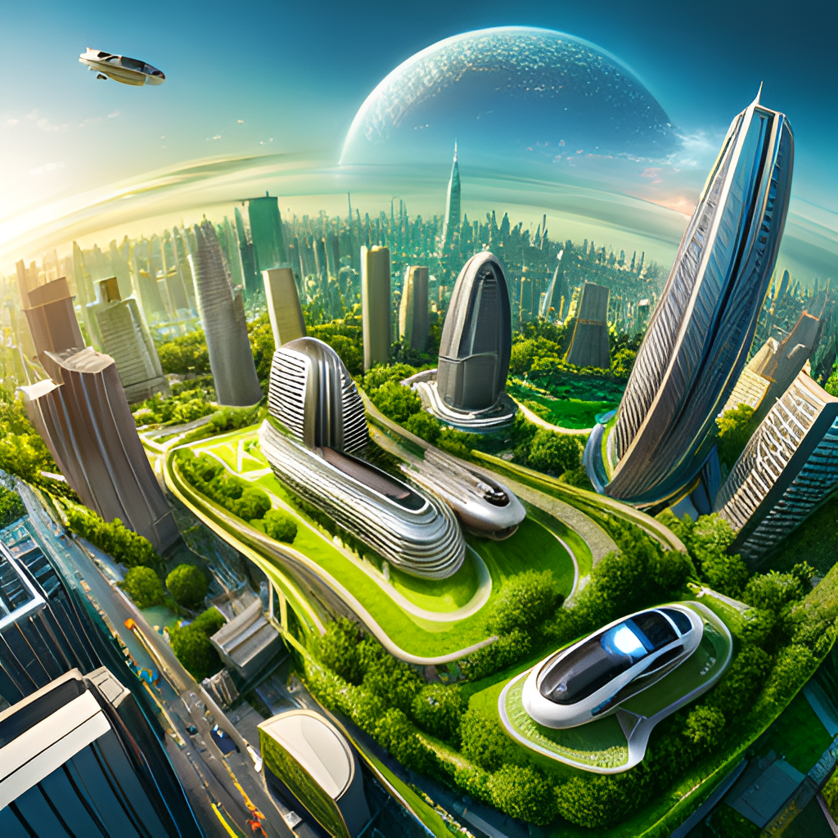
Future of the Internet of Things
As technology continues to advance, the IoT will become more integrated into our daily lives, with smart homes, cities, and transportation systems becoming the norm.
There will also be increased emphasis on sustainability and energy efficiency, with the IoT helping to monitor and reduce energy consumption.

Slide 19
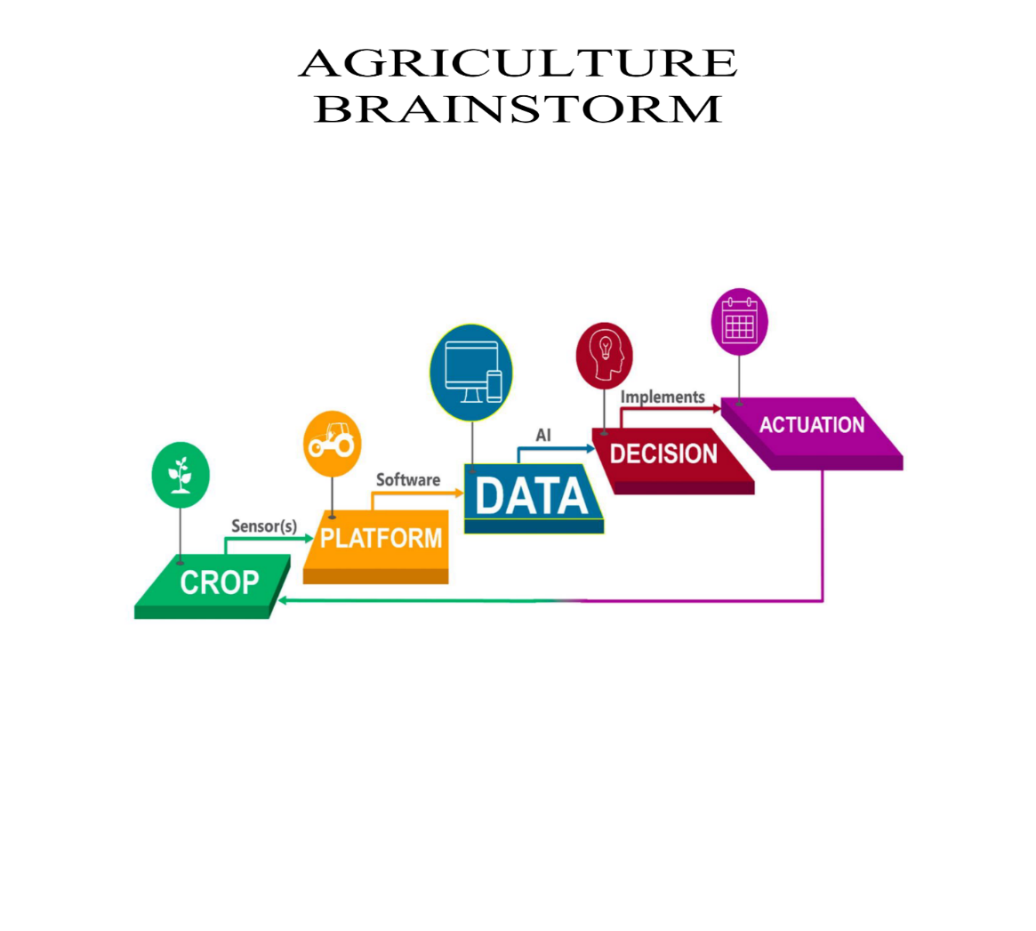
BRAINSTORM

Slide 20
PROBLEM STATEMENT
Land Tenure System
The land tenure system practiced in India is suffering from lot of defects. Insecurity of tenancy was a big problem for the tenants, particularly during the pre- independence period.
Inequality in Land Distribution
The distribution of agricultural land in India has not been fairly distributed. Rather there is a considerable degree of concentration of land holding among the rich landlords, farmers and money lenders throughout the country.
Cropping Pattern
The cropping pattern which shows the proportion of the area under different crops at a definite point of time is an important indicator of development and diversification of the sector.

Slide 21
Instability and Fluctuations
Indian agriculture is continuously subjected to instability arising out of fluctuations in weather and gamble of monsoon.
Poor Farming Techniques and Agricultural Practices
The farmers in India have been adopting orthodox and inefficient method and technique of cultivation.
Instability in Agricultural Prices
Fluctuation in the prices of agricultural products poses a big threat to Indian agriculture.
Agricultural Indebtedness
One of the greatest problems of Indian agriculture is its growing indebtedness. The rural people are borrowing a heavy amount of loan regularly for meeting their requirements needed for production, consumption and also for meeting their social commitments.

Slide 22
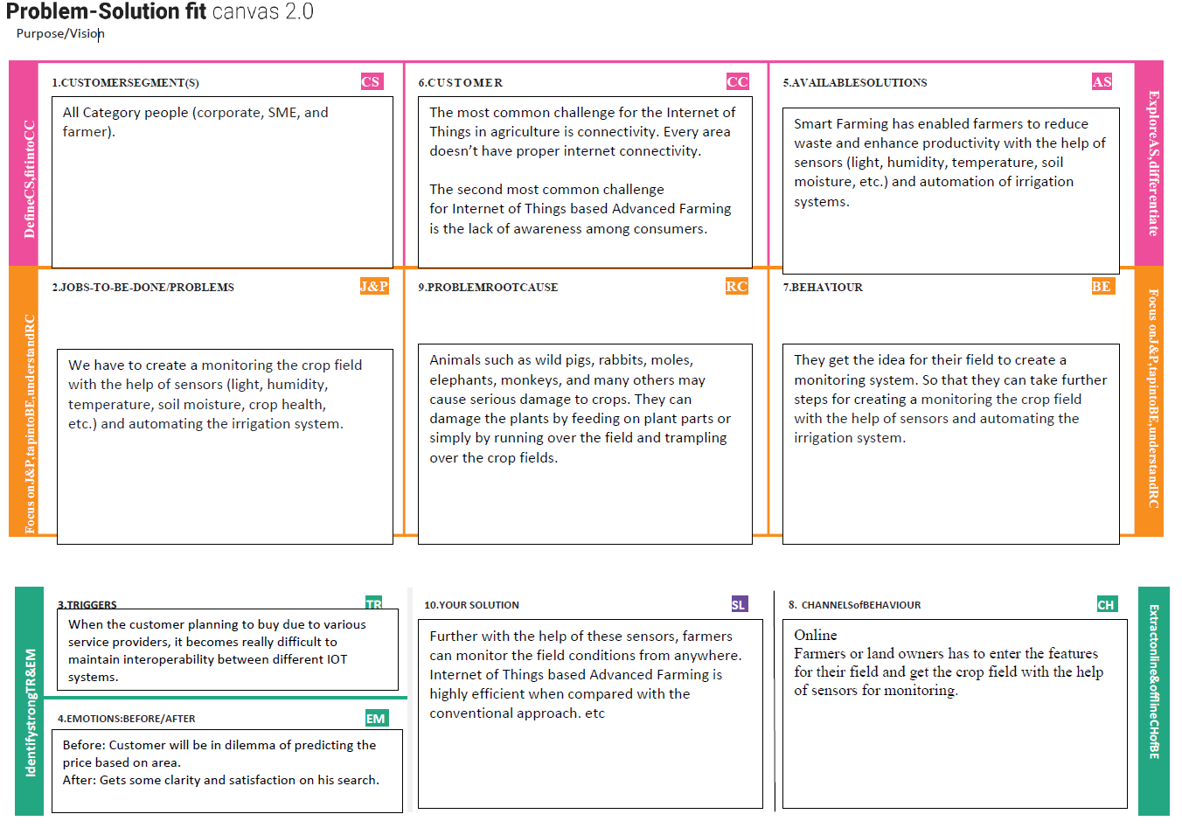
IMPLEMENTATION PROJECT DESIGN PHASE 1

Slide 23
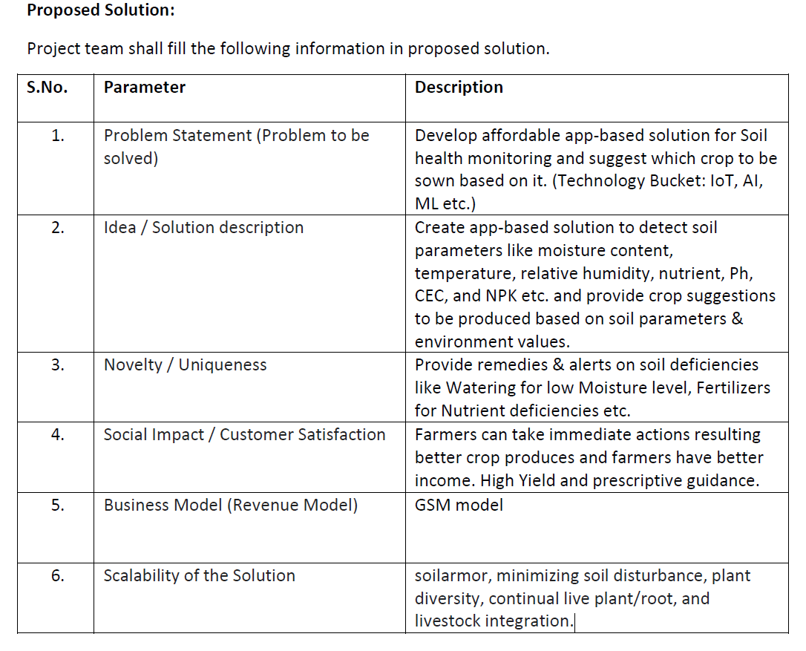

Slide 24
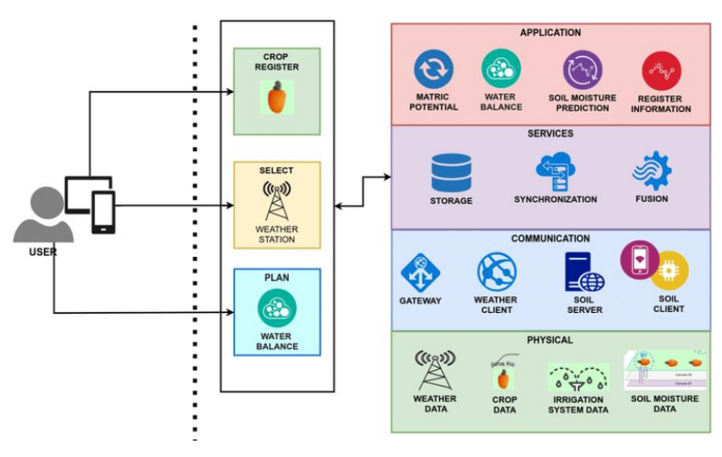
Solution architecture

Slide 25
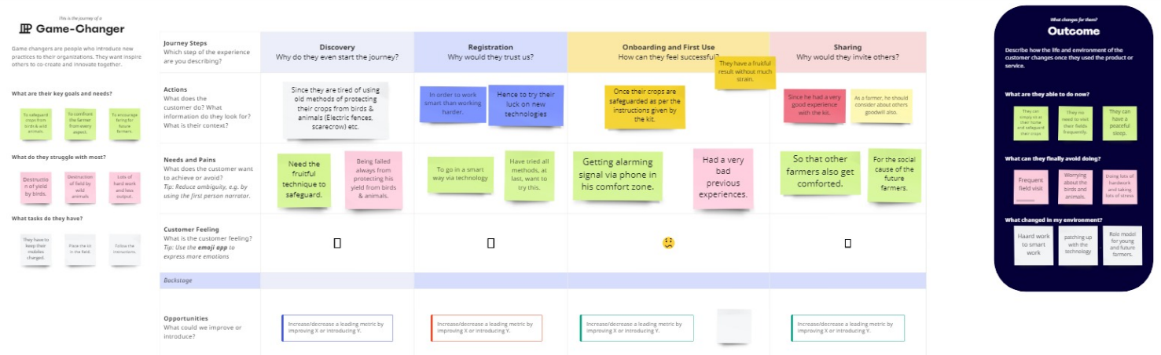
SYSTEM TESTING PROJECT DESIGN PHASE 2 Customer journey map

Slide 26
Data Flow Diagram & User Stories
Data Flow Diagrams
A Data Flow Diagram (DFD) is a traditional visual representation of the information flows within a system. A neat and clear DFD can depict the right amount of the system requirement graphically.
USER STORIES
A systematic survey of 160 households in district was conducted to study the extent of crop raiding by wild animals. Almost all respondents (97.5%) reported crop damage by wild animals. Most crop damage was done by deer (91.1%).

Slide 27
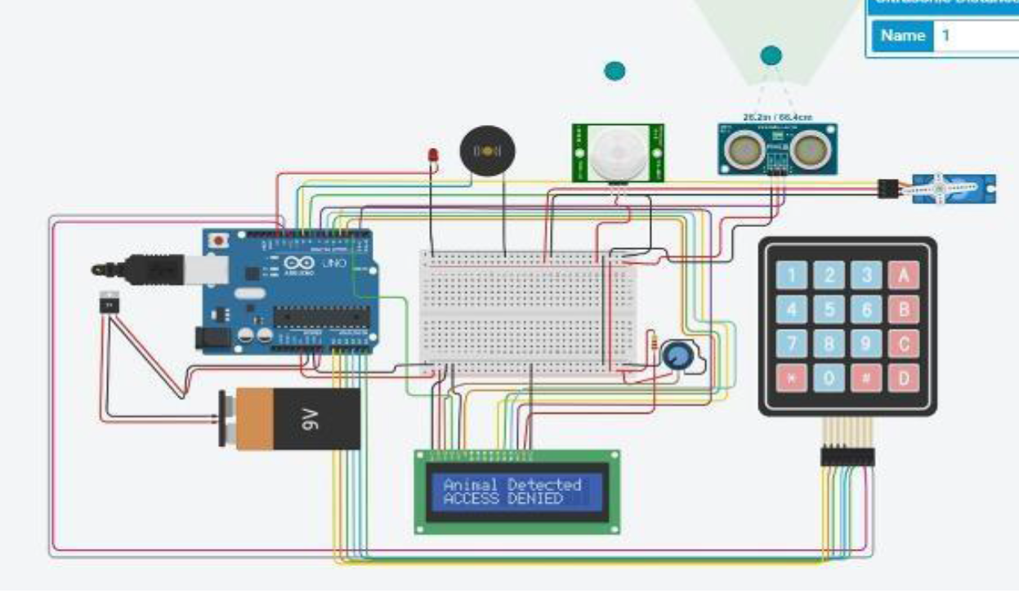
Data Flow Architecture

Slide 28
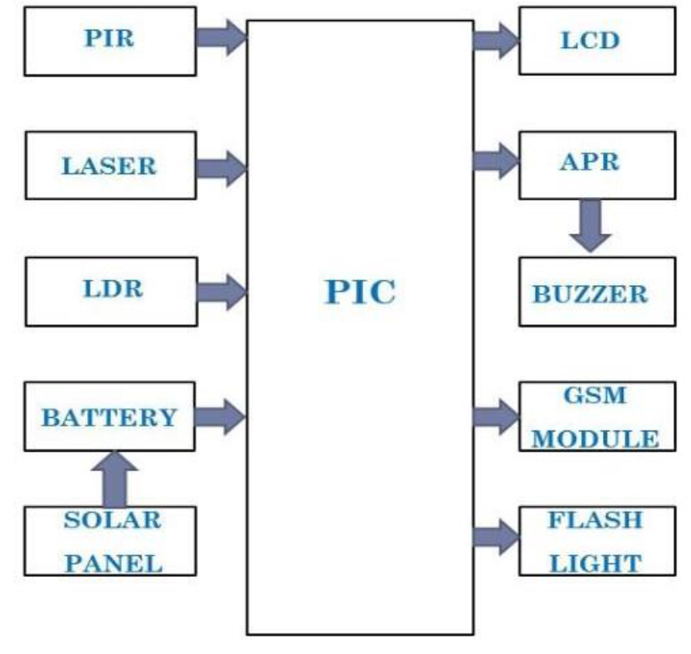
DATA FLOW DIAGRAM

Slide 29
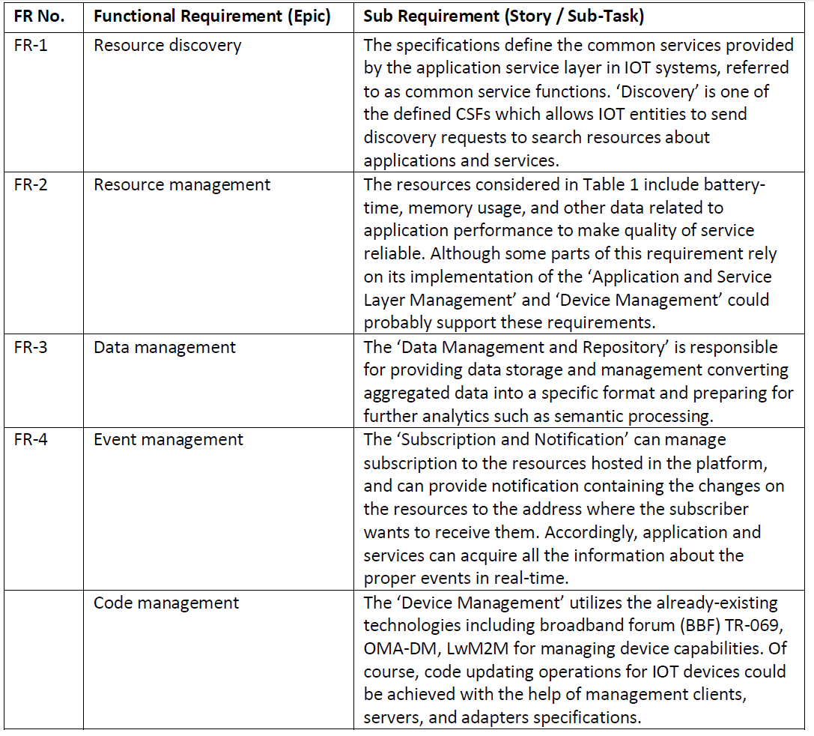
SOLUTION REQUIREMENTS (FUNCTIONAL&NONFUNCTIONAL)

Slide 30
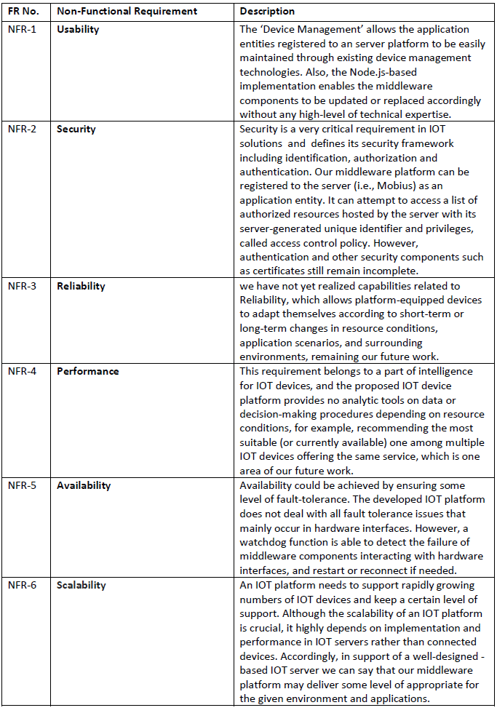

Slide 31
Experimentation Work
Tool used: Proetus 8
Platform used: Windows 10 64 bit
System Configuration: i5 7th gen
Results: Positive

Slide 32
OUTPUT

Slide 33
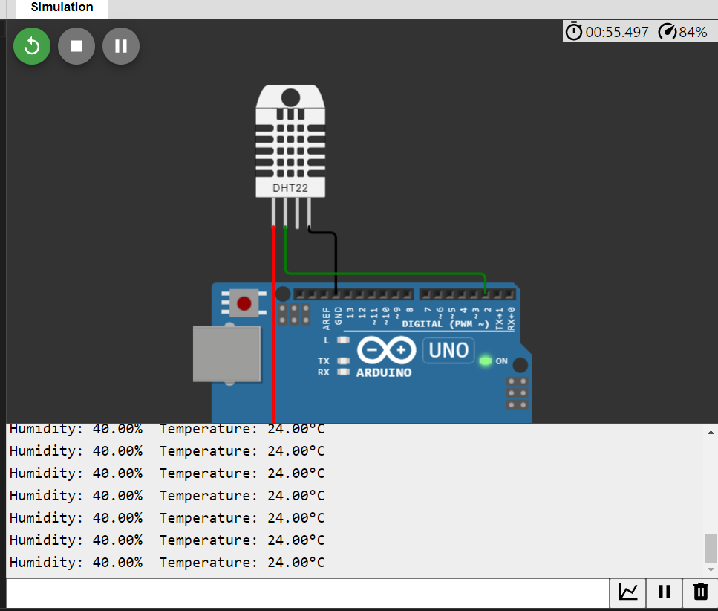

Slide 34
AFTER MEASURING DISTANCE

Slide 35
Conclusion
Using IoT technology, farmers and producers may better manage their resources, such as fertilizer consumption and the number of trips made by farm vehicles, while minimizing waste and maximizing productivity, including water, electricity, andother inputs.
In IoT smart farming systems, sensors monitor the agricultural field and automate the irrigation system. Farmers can monitor their fields from anywhere.
This paper concluded the research direction in smart agriculture and farming.
Technologyhas shaped agriculture’s history.
Historians have identified several agricultural revolutions that changed practice and output.
Technological advances have fuelled these revolutions.
The Industrial Revolution mechanized agriculture, improving farm labour productivity.
synthetic fertilizers and insecticides, massproduced tractors, and agricultural aircraft for aerial pesticide application were developed.
Precision farming, disease monitoring, agricultural drones, satellite imagery, and sensors are just ways technology makes farming easier for farmers.

Slide 36
REFERENCE
1. Setiaji, B., & Wibowo, F. W. (2016, January). Chatbot using a knowledge in
database: human-to-machine conversation modeling. In 2016 7th International Conference on Intelligent Systems, Modelling and Simulation (ISMS) (pp. 72-77). IEEE.
2. Bibault, J. E., Chaix, B., Nectoux, P., Pienkowski, A., Guillemasé, A., & Brouard, B. (2019). Healthcare ex Machina: Are conversational agents ready for prime time in oncology?. Clinical and translational radiation oncology, 16, 55-59.
3. Atiyah, A., Jusoh, S., & Almajali, S. (2018, July). An efficient search for context-based chatbots. In 2018 8th International Conference on Computer Science and Information Technology (CSIT) (pp. 125-130). IEEE.
4. Argal, A., Gupta, S., Modi, A., Pandey, P., Shim, S., & Choo, C. (2018, January). Intelligent travel chatbot for predictive recommendation in echo platform.
5. Avalverde, D. (2019). A Brief History of Chatbots. Perception, Control, Cognition. Retrieved March 9, 2019 from:
6. Do, H. J., & Fu, W. T. (2016, October). Empathic virtual assistant for healthcare information with positive emotional experience. In 2016 IEEE International Conference on Healthcare Informatics (ICHI) (pp. 318-318). IEEE.

Slide 37

THANK YOU!!

